Slide 1




Dynatrace & ServiceNow
David Jones
Director SE
Dynatrace
Jairam Ramaswany
ES Architect
Dynatrace
Wolfgang Beer
Product Manager
Dynatrace
Integrating Dynatrace with ServiceNow (ITOM and ITSM)
Luis Escobar
Autonomous Cloud Architect
Dynatrace

Slide 2
Agenda
Introduction
Pre-requisites
Discuss Integration scope
Deep dive - ITSM and CMDB Integration
Event Management/ITOM
Build a Problem Remediation workflow in SNOW
Roadmap
Closing/Any questions

Slide 3


Customer use cases and combined value
+
+
What are the driving requirements?
1
Manage enterprise silos and map responsibility
2
Manage the big picture of service infrastructure in real-time
3
Manage change within service infrastructure towards automation
Notes:
Dynatrace is unique in the way it correlates and delivers IMPACT and ROOT CAUSE to ServiceNow
Dynatrace provides FULL transactional insights
Dynatrace information is REALTIME!

Slide 4
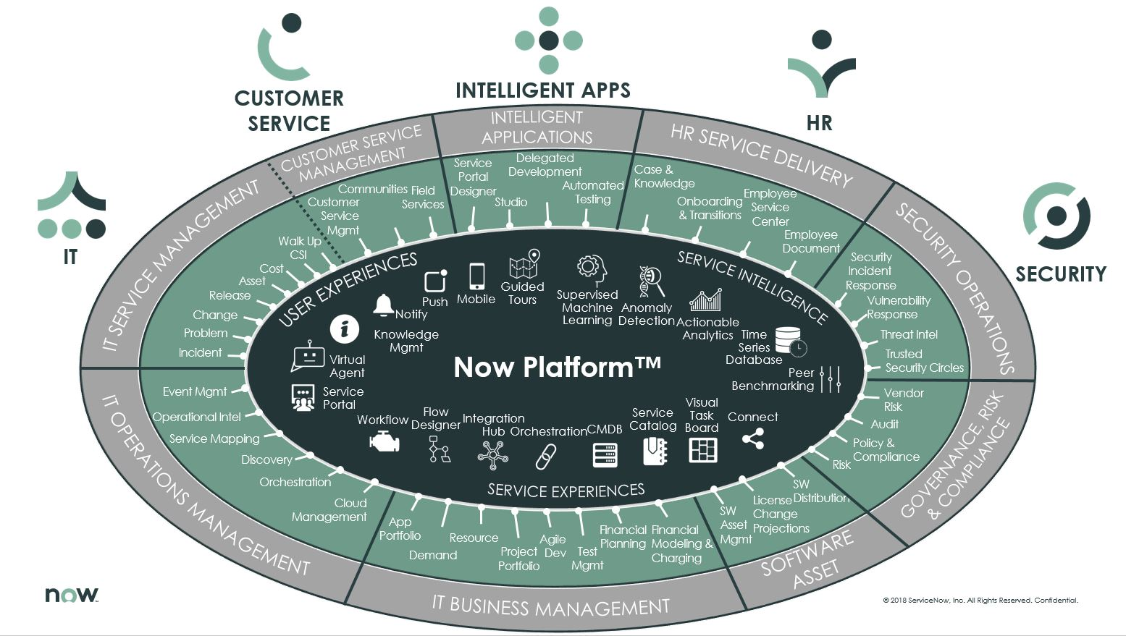

Slide 5

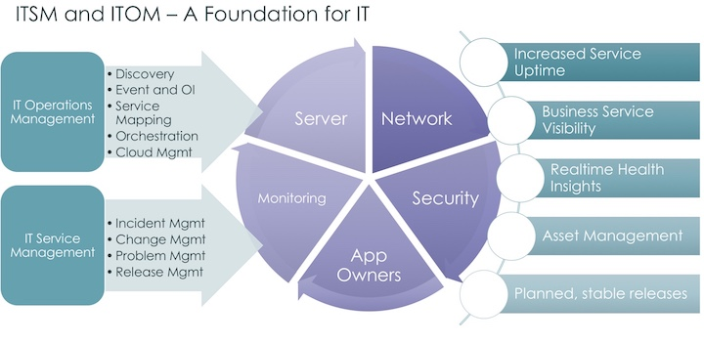












Dynatrace and ServiceNow

Slide 6
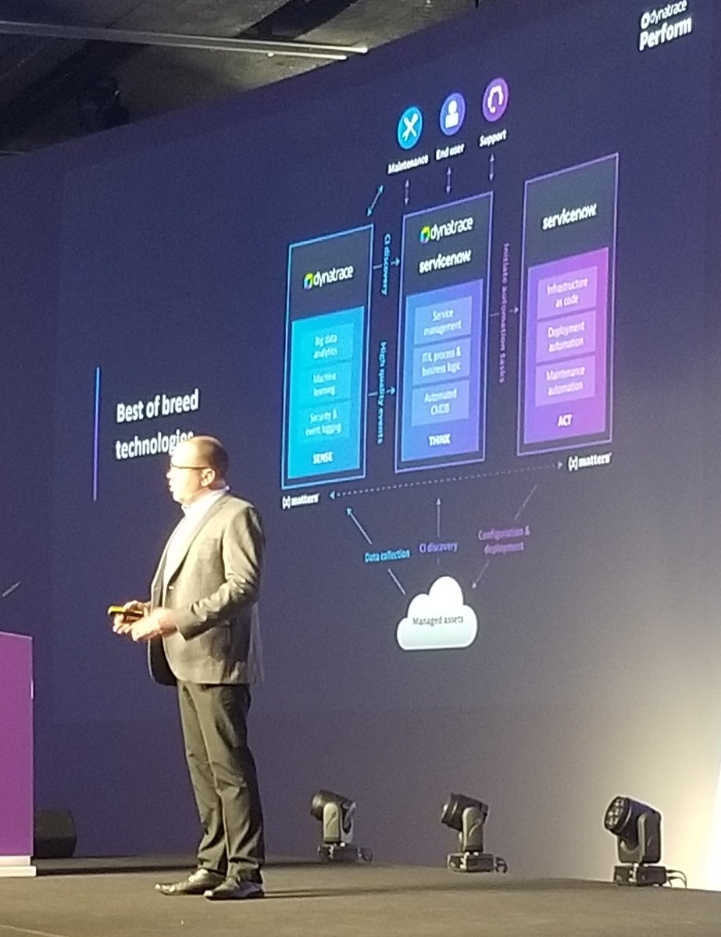

SENSE | THINK | ACT

Slide 7



Increase of Complexity and Lack of Insights
IT Complexity
Increased User Expectations
Lack of Visibility
“My IT environment is becoming more and more complex to manage and control”
“Customers are demanding better experiences and have no tolerance for failure”
“I don’t know what’s happening in my environment, and I can’t quickly address problems”
Companies are adopting new technologies – hybrid, multi-cloud, microservice environments – at a rapid pace
Companies must deliver more products faster in better quality and with minimal downtime in order to be competitive
Companies need to quickly identify problems, pinpoint root cause, and automatically remediate issues

Slide 8
Enterprise-Class Observability and Workflows Dynatrace and ServiceNow provide complementary platforms to customers
Complete
Visibility
Dynatrace and ServiceNow have complementary visibility capabilities which feed and enrich the CMDB
Actionable
Insights
ServiceNow alerts users when a critical issue arises, and Dynatrace quickly identifies root cause of IT problems
Rapid
Resolution
Once Dynatrace tracks down a problem, ServiceNow can remediate the problem with orchestration and workflows

Slide 9
Complete Visibility ServiceNow and Dynatrace provide a complete picture of the enterprise
Use ServiceNow
ITOM Visibility to get a complete picture of the infrastructure
Dynatrace
SmartScape
Real-time visibility into mission-critical applications
ServiceNow agentless discovery of the entire IT infrastructure with business-level context (who owns this service, how important it is)
ServiceNow
ITOM Visibility
Maps out on-prem and cloud landscape with business context
Use Dynatrace to get a full stack view of your mission-critical applications
Dynatrace agent-based technology provides you real-time insights into your entire stack, app topology, services and dependencies
Enriched CMDB across services, applications, infrastructure with business context and dependencies
ServiceNow CMDB
Enhanced visibility into business-critical applications with automated real-time data, ensuring the CMDB is always current
Enhanced visibility leads to better operational performance, less downtime, and more satisfied users

Slide 10
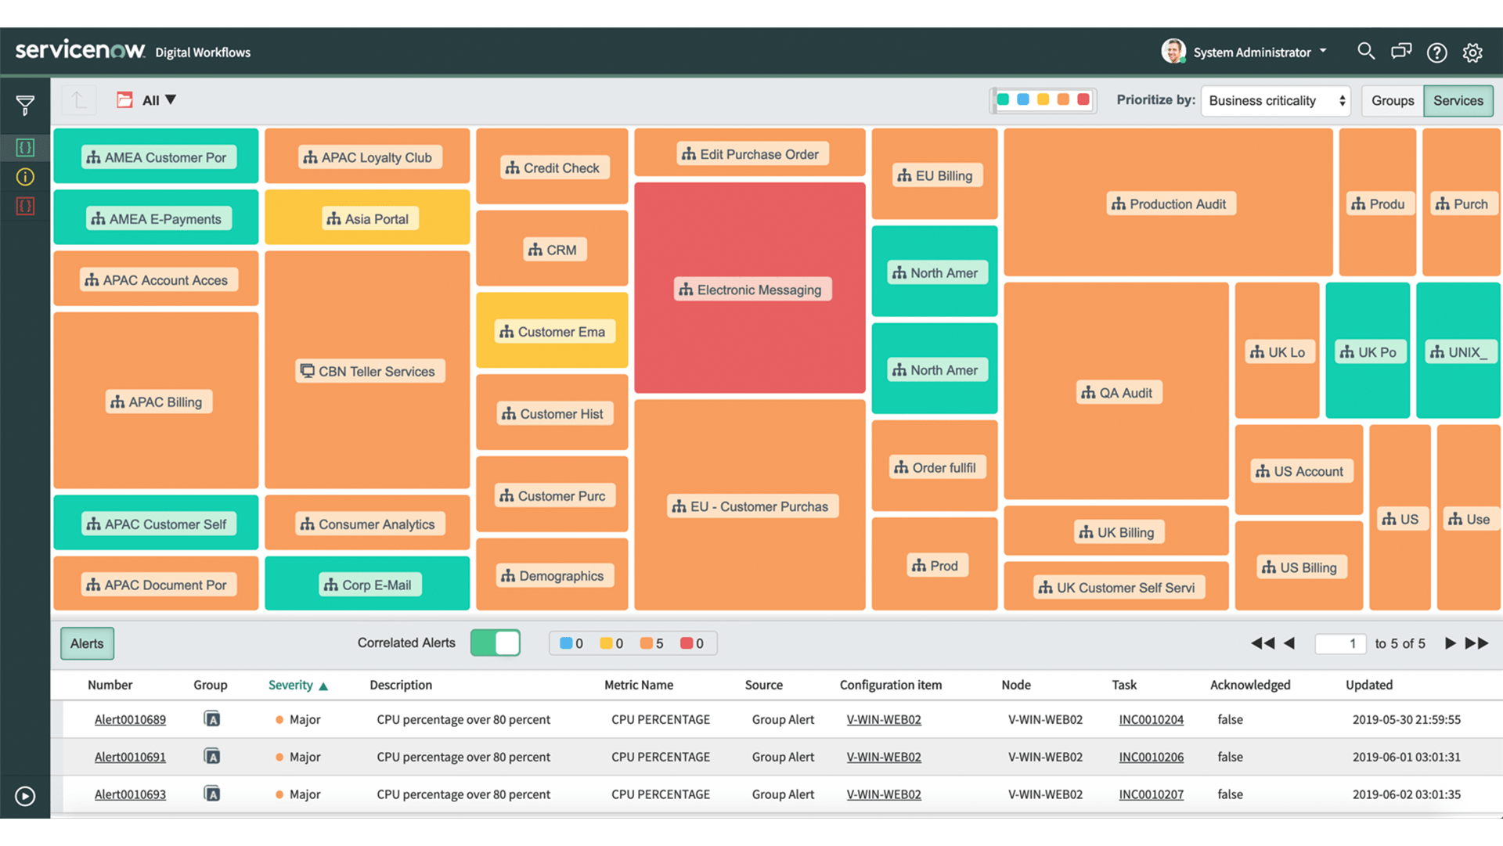
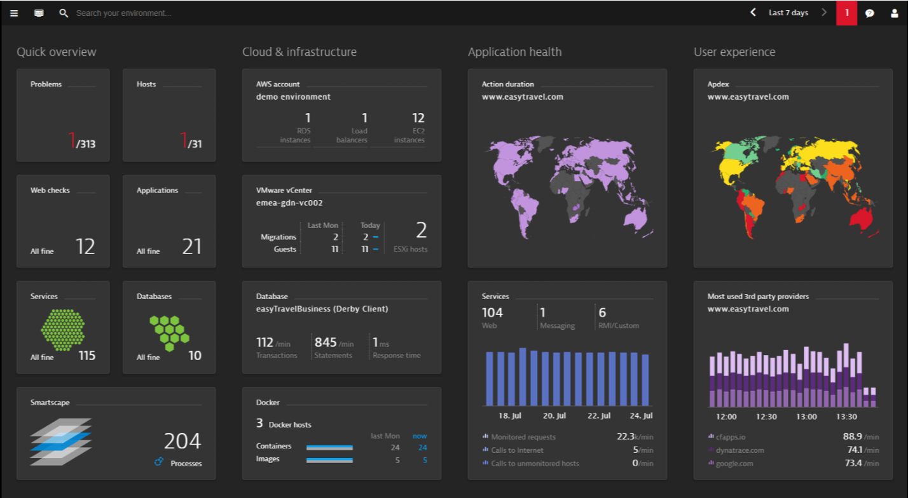
Actionable Insights Complementary AI technologies help identify issues faster
ServiceNow Event Management aggregates, correlates and prioritizes enterprise IT events through a single pane of glass
Dynatrace OneAgent provides unparalleled real-time actionable insights to rapidly get to the root cause of issues using advanced AI
ServiceNow business process related information (ITSM, CSM) can enrich Dynatrace detected technical root-causes

Slide 11
Rapid Resolution Once a problem has been identified, remediate issues quickly
Correlate events in Event Management
Generate ticket in ITSM
Notify impacted users in CSM
Notify IT or DevOps teams via Major Incident
Kick-off automated remediation workflows via Orchestration
Dynatrace Detects
an Issue and
Identifies Root Cause
ServiceNow
Takes Action
Information on problem resolution can be tracked across both systems; bi-directional data flow also helps refine ML models for both systems

Slide 12


Pre-Requisites for lab
Connection to the internet
Personal ServiceNow Instance
As sent out in this Hotday’s pre-requisites, please use your own free personal ServiceNow instance during our Hotday session.
You can register and request a free personal ServiceNow developer instance (New York release) on the following Website: https://developer.servicenow.com/

Slide 13
Integration Scope

Slide 14
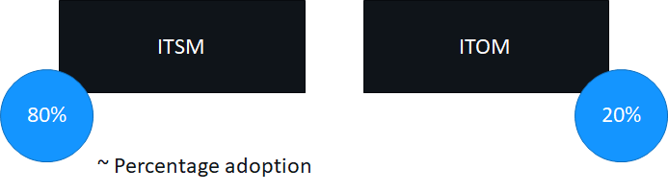
ServiceNow Integration Best Practices
Dynatrace integration best-practices, successfully applied at different Dynatrace customers
Two main areas, depending on customers‘ ServiceNow implementation level

Slide 15



Dynatrace ServiceNow Integration Observations
Customer ServiceNow environment unique
Customized processes and workflows
CI ownership customized
Notes:
No customer‘s ServiceNow environment is the same
Highly customized processes and workflows
CMDB present, no CMDB, multiple Discovery tools, static managament of CMDB, etc.
Ownership of CI‘s managed in ServiceNow, sometimes outside.
Often ownership of CIs is not completely given
Customers follow different approaches to integrate into their own workflows

Slide 16
Simple Ticketing
ITSM
Simple Ticketing
Simple Ticketing + CI assignment
Custom Ticketing
Ticketing & CMDB sync
Ticketing with Tags & MZs
Alerting profiles
Dynatrace Pushes only Problems to ServiceNow Incident
No CMDB Sync from Dynatrace
No Auto CI assignment
Textual Information from Dynatrace
Backlink to Dynatrace
Notes:
Many customers use the simple incident creation approach
Scope of this integration:
Configure out-of-the-box Dynatrace integration to push incidents into incident table
Incidents contain the textual information what Dynatrace detected
Backlink to Dynatrace for deeper analysis
No CMDB sync with Dynatrace, no automatic CI assignment
Assignment is manual process within ServiceNow, like the JIRA integration
Good practice to first send a Test incident from Dynatrace to make sure authentication and incident creation is happening at the beginning

Slide 17
Simple Ticketing + partial CI assignment
ITSM
Simple Ticketing
Simple Ticketing + CI assignment
Custom Ticketing
Ticketing & CMDB sync
Ticketing with Tags & MZs
Alerting profiles
Dynatrace Pushes only Problems to ServiceNow Incident
Partial CI Assignment
Using the server name
No CMDB sync with Dynatrace
Textual Information from Dynatrace
Not for Dynatrace services, applications or synthetic tests
Backlink to Dynatrace
Notes:
Scope of this integration:
Configure out-of-the-box Dynatrace integration to push incidents into incident table
Incidents contain the textual information what Dynatrace detected
Backlink to Dynatrace for deeper analysis
No CMDB sync with Dynatrace
Assignment is semi-automatic process, where server CIs are assigned by using the server name
Does not work for Dynatrace services, applications or synthetic tests
Good practice to make sure to check if Dynatrace Server CI names match with CI names extracted by other Discovery tools else will have to develop a mapping table

Slide 18
Custom Ticketing
ITSM
Simple Ticketing
Simple Ticketing + CI assignment
Custom Ticketing
Ticketing & CMDB sync
Ticketing with Tags & MZs
Alerting profiles
Dynatrace Pushes Custom payload for Problems
Custom scripted REST receiver in ServiceNow
No CMDB sync with Dynatrace
Custom Textual Information from Dynatrace
More flexibility with ‘raw’ data
No Auto CI assignment
Notes:
Scope of this integration:
Configure custom Dynatrace integration to push custom HTTP POSTs to a custom scripted REST receiver at the ServiceNow side
No CMDB sync with Dynatrace
Assignment can be an automatic process, depending on the customers receiving script
Why don’t they use the Dynatrace out-of-the-box ServiceNow integration?
More flexibility in terms of receiving all the ‘raw’ problem data as JSON payload
Good Practice to make sure to check the Dynatrace Problem API and know its limitations so you can customize it accordingly

Slide 19
Ticketing & CMDB Sync
ITSM
Simple Ticketing
Simple Ticketing + CI assignment
Custom Ticketing
Ticketing & CMDB sync
Ticketing with Tags & MZs
Alerting profile
Dynatrace Pushes Problems to ServiceNow Incident
CMDB Sync from Dynatrace enabled
CI types – Hosts, Processes, Services
CI Assignment is automatic
Textual Information from Dynatrace
Backlink to Dynatrace
Notes:
Scope of this integration:
Configure out-of-the-box Dynatrace integration to push incidents into incident table
Incidents contain the textual information what Dynatrace detected
Backlink to Dynatrace for deeper analysis
CMDB CIs are created by Dynatrace (servers, supported processes and services)
Assignment is an automatic process, where server CIs are assigned by using either the server name or the unique Dynatrace ID
Does not work for Dynatrace synthetic test and RUM applications
Good practice to make sure all relationship types Dynatrace uses is present in your CMDB for Service Mapping and making sure not have the Correlation Id field overlap with other integrations

Slide 20
Ticketing & Tag or Management Zone assignment
ITSM
Simple Ticketing
Simple Ticketing + CI assignment
Custom Ticketing
Ticketing & CMDB sync
Ticketing with Tags & MZs
Alerting profiles
Dynatrace Pushes Problems to ServiceNow Incident
Textual Information from Dynatrace
Incident - all tags of affected CIs in Dynatrace
Backlink to Dynatrace
No CMDB sync with Dynatrace
No one-to-one CI assignment
Assignment group – Tags or Management Zones
Notes:
Scope of this integration:
Configure out-of-the-box Dynatrace integration to push incidents into incident table
Incidents contain the textual information what Dynatrace detected
Backlink to Dynatrace for deeper analysis
Incident also contains all tags of affected CIs on the Dynatrace side
No CMDB sync with Dynatrace
Assignment group is selected by using Dynatrace Tags or Management Zones
No one-to-one CI assignment but offers a grouped assignment along responsibility groups or teams

Slide 21
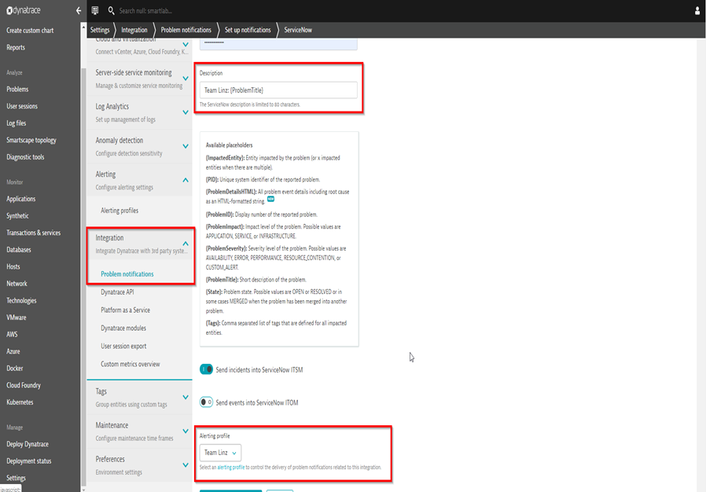
Alerting Profiles
ITSM
Simple Ticketing
Simple Ticketing + CI assignment
Custom Ticketing
Ticketing & CMDB sync
Ticketing with Tags & MZs
Alerting profiles

Slide 22
Event Management Integration
ITOM
Events Integration
Event Severities
Host Events Payload
Webservice Events Payload
Customer Story
Dynatrace Pushes Events to ServiceNow Events
Uses Bulk events API in ServiceNow
Host based events
Webservice events
Web application events
Host process events
Appropriate Alerts are raised based on Alert rules
Notes:
Scope of this integration:
Configure out-of-the-box Dynatrace integration to push Events into Events module
Data passed across directly from Dynatrace to Event API in SNOW
Appropriate Alerts are raised based on Alert rules
Push events into ServiceNow by using the ‚Events WebService Bulk API‘
We will push following events
Host based events, such as
CPU, network, metric, etc. events
Host process events, such as
CPU, network, metric, offline, etc.
Webservice events?
Slowdown, error rate increase
Web application events?
Slowdown, error rate increase, traffic spikes and drops

Slide 23
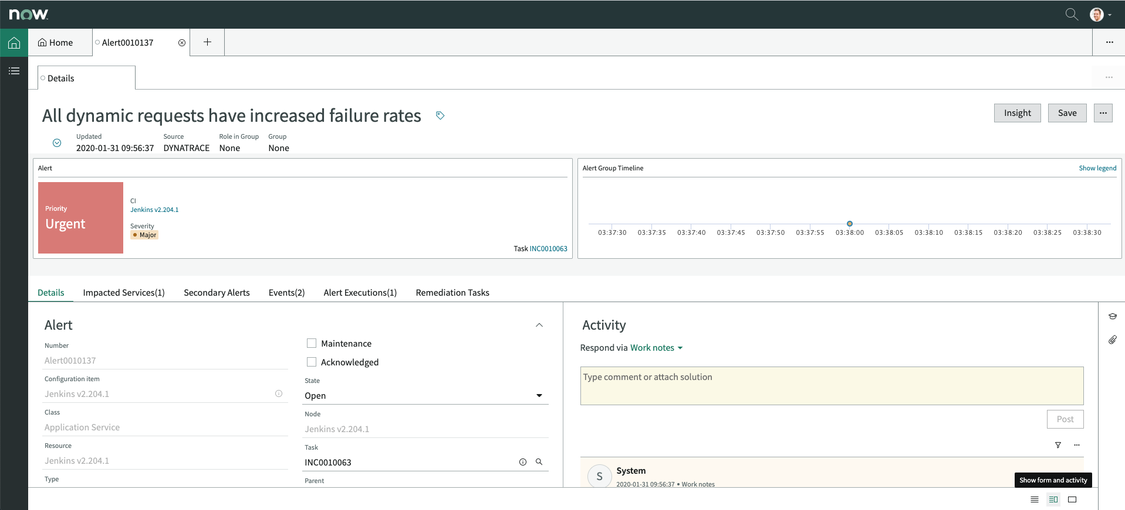
Event Management Integration Viewing alerts in the ServiceNow Workspace
ITOM
Events Integration
Event Severities
Host Events Payload
Webservice Events Payload
Customer Story
Notes:
Scope of this integration:
Configure out-of-the-box Dynatrace integration to push Events into Events module
Data passed across directly from Dynatrace to Event API in SNOW
Appropriate Alerts are raised based on Alert rules
Push events into ServiceNow by using the ‚Events WebService Bulk API‘
We will push following events
Host based events, such as
CPU, network, metric, etc. events
Host process events, such as
CPU, network, metric, offline, etc.
Webservice events?
Slowdown, error rate increase
Web application events?
Slowdown, error rate increase, traffic spikes and drops

Slide 24
Event Severities
ITOM
Events Integration
Event Severities
Host Events Payload
Webservice Events Payload
Customer Story
ServiceNow Events | Dynatrace Events
1 - Critical | Availability
2 - Major | Error
3 - Minor | Slowdown
4 - Warning | Resource
5 - Clear | Resolved
Notes:
Event:
1 = Critical maps to Dynatrace AVAILABILITY event severity
2 = Major maps to Dynatrace ERROR event severity
3 = Minor maps to Dynatrace SLOWDOWN event severity
4 = Warning maps to Dynatrace RESOURCE event severity
0 = Clear maps to Dynatrace event RESOLVED state

Slide 25
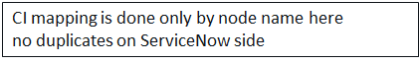
Dynatrace Host event Payload example
ITOM
Events Integration
Event Severities
Host Events Payload
Webservice Events Payload
Customer Story
{
"source" : "DYNATRACE",
"node" : "LinuxHost03" ,
"type" : "CPU saturation",
"resource" : "CPU_USAGE ",
"severity" : 4, (NOT send that for opening of events)
"description" : "CPU saturation",
"additional_info" : "{ context: "CPU_USAGE", value: 97.46600341796875, unit: "Percent"}",
"event_class" : "CPU_SATURATED"
}

Slide 26
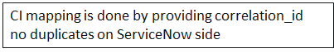
Webservice Events Payload example
ITOM
Events Integration
Event Severities
Host Events Payload
Webservice Events Payload
Customer Story
{
"source" : "DYNATRACE",
"node" : "" ,
"ci_identifier" : "{ 'correlation_id':'SERVICE-83788C43673A7462' }"
"type" : "Response time degredation",
"resource" : "",
"severity" : 3,
"description" : "Response time degredation",
"additional_info" : "{
context: "RESPONSE_TIME_50TH_PERCENTILE",
value: 4446548.5,
unit: "MicroSecond"
}",
"event_class" : "SERVICE_RESPONSE_TIME_DEGRADED"
}

Slide 27
Customer Story – Financial services entity Dynatrace Integration with ServiceNow Event Management Results
ITOM
Events Integration
Event Severities
Host Events Payload
Webservice Events Payload
Customer Story
Automated prioritization, and routing of resulting ServiceNow Incidents
implementation of thorough Dynatrace tagging to directly associate Dynatrace events to the affected ServiceNow Application Service
Dynatrace entities automatically bind to ServiceNow CIs
Ability to Kick-off automated remediation workflows using ServiceNow flow designer or Orchestration
Easily access Dynatrace Problems directly from a ServiceNow Alert

Slide 28
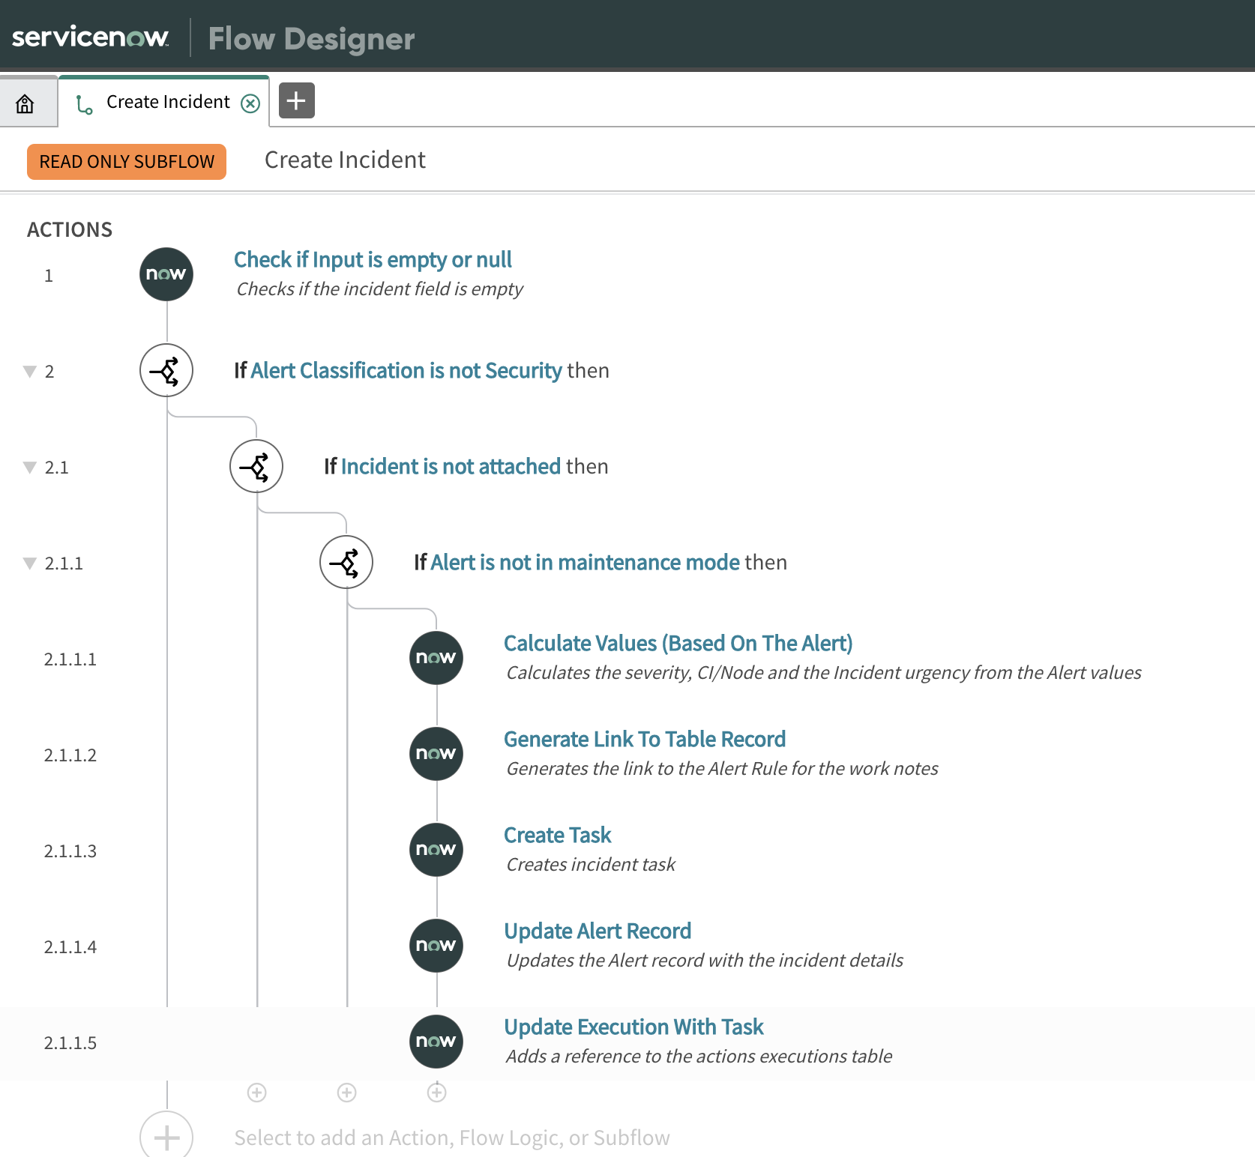
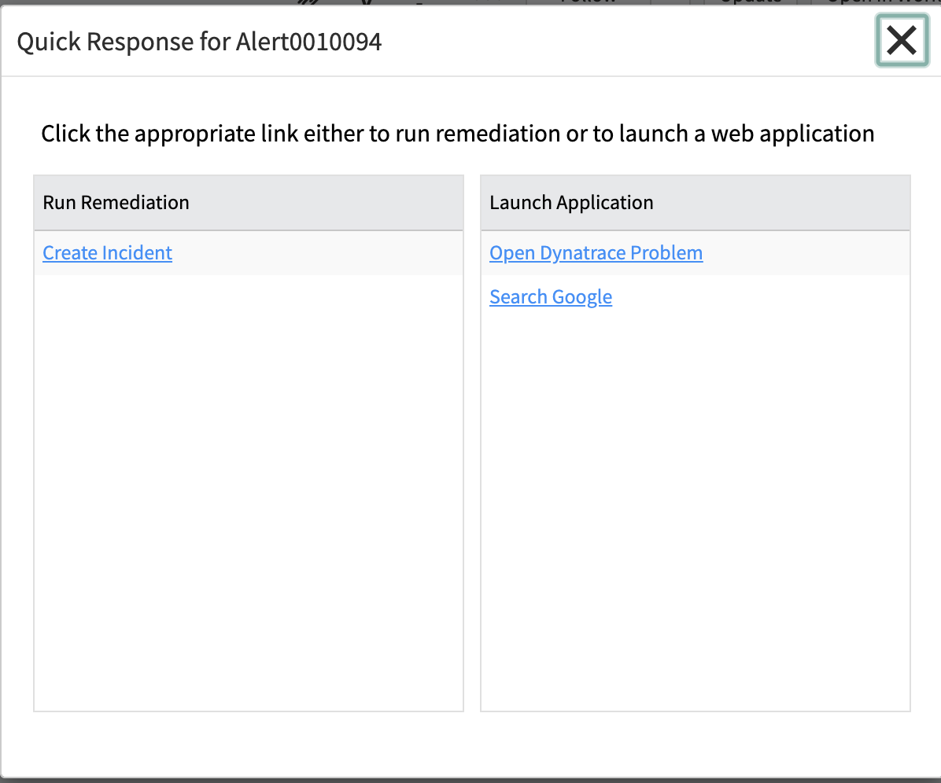
Customer Story – Financial services entity Dynatrace Integration with ServiceNow Event Management Results
ITOM
Events Integration
Event Severities
Host Events Payload
Webservice Events Payload
Customer Story

Slide 29


Slide 30
Integration setup

Slide 31
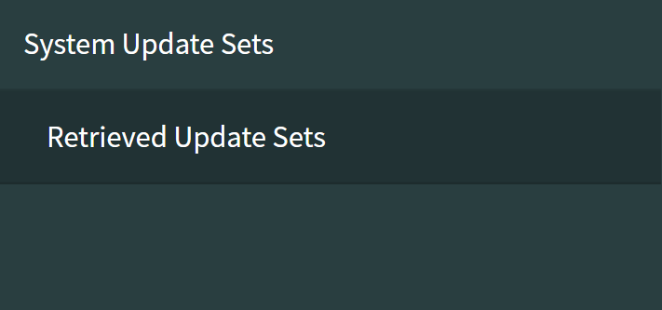
Tenant Information
Lab 1
Steps 1 - 3
Step 1: Login to your Shared Dynatrace Tenant:
URL : https://vgv23234.sprint.dynatracelabs.com
User: student2180Perform2020@trial.dynatracelabs.com
Pwd: Dyn@trac3
Step 2 : Login to your ServiceNow Personal Instance/Certified Instance
Step 3: Download the Dynatrace app from our GitHub repository:
https://github.com/wolfgangB33r/Perform2020Hotday
Upload the Update set (.xml file) to this ServiceNow instance once you have setup your login etc
Go to Retrieved Update Sets -> Click on Import Update Set from XML under Related Links

Slide 32
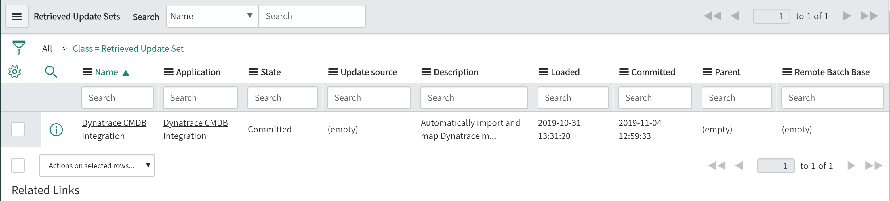
Update Set
Lab 1
Steps 4
Step 4 : Click on the ‘Dynatrace CMDB Integration’ under Name and click on ‘Preview Update set’.

Slide 33
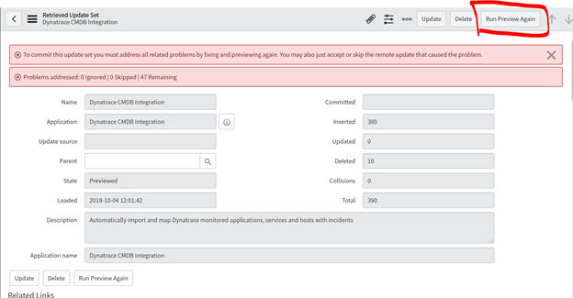
Post Preview of Update Set
Lab 1
This is the screenshot when you run Preview on ‘Preview Update set’.

Slide 34
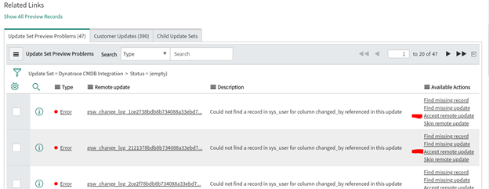
Post Preview of Update Set
Lab 1
Steps 5 -6
Step 5 : Once its previewed, there might be errors which you can go ahead and select ‘Accept Remote updates’
Step 6 : Then click on button ‘Commit’ Update Set and its finally installed

Slide 35
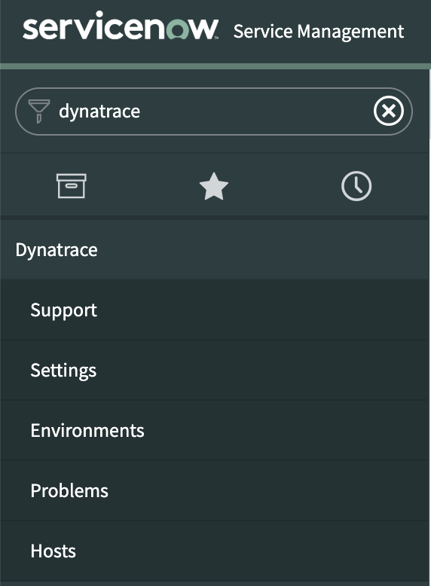
Filter Navigator Lookup
Lab 1
Step 7
Step 7 : Search for ‘Dynatrace’ in the Filter Navigator and if you find it BINGO!

Slide 36
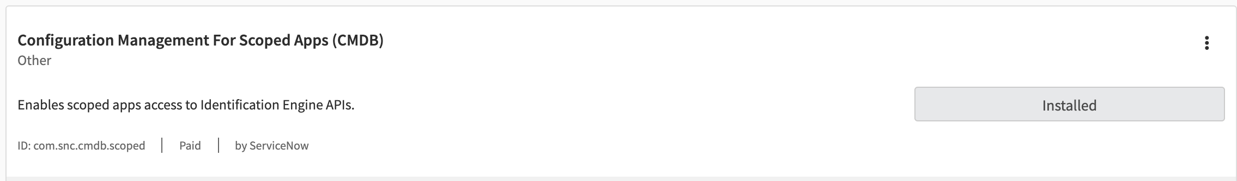
Plugin Activation
Lab 1
Step 9
Step 9 : Activate the Configuration Management for Scoped Apps plugin within your ServiceNow instance
Navigate to System Definition > Plugins.
On the plugins search box enter “Configuration Management For Scoped Apps (CMDB)”
Click on Install

Slide 37
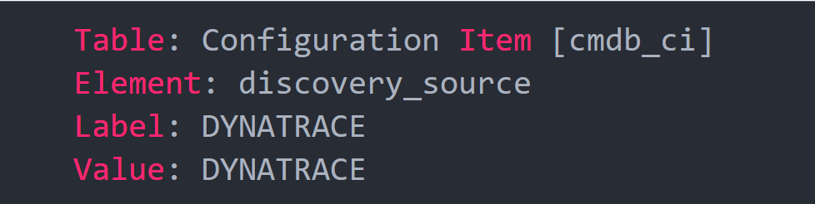
Plugin Activation
Lab 1
Step 10
Step 10 : Create a discovery source DYNATRACE entry
To allow Dynatrace to report discovered CIs into your CMDB you must create a new discovery data source called DYNATRACE. Perform the following steps:
Navigate to System Definition > Choice Lists.
Click the New button.
Create a new entry with the following details:

Slide 38
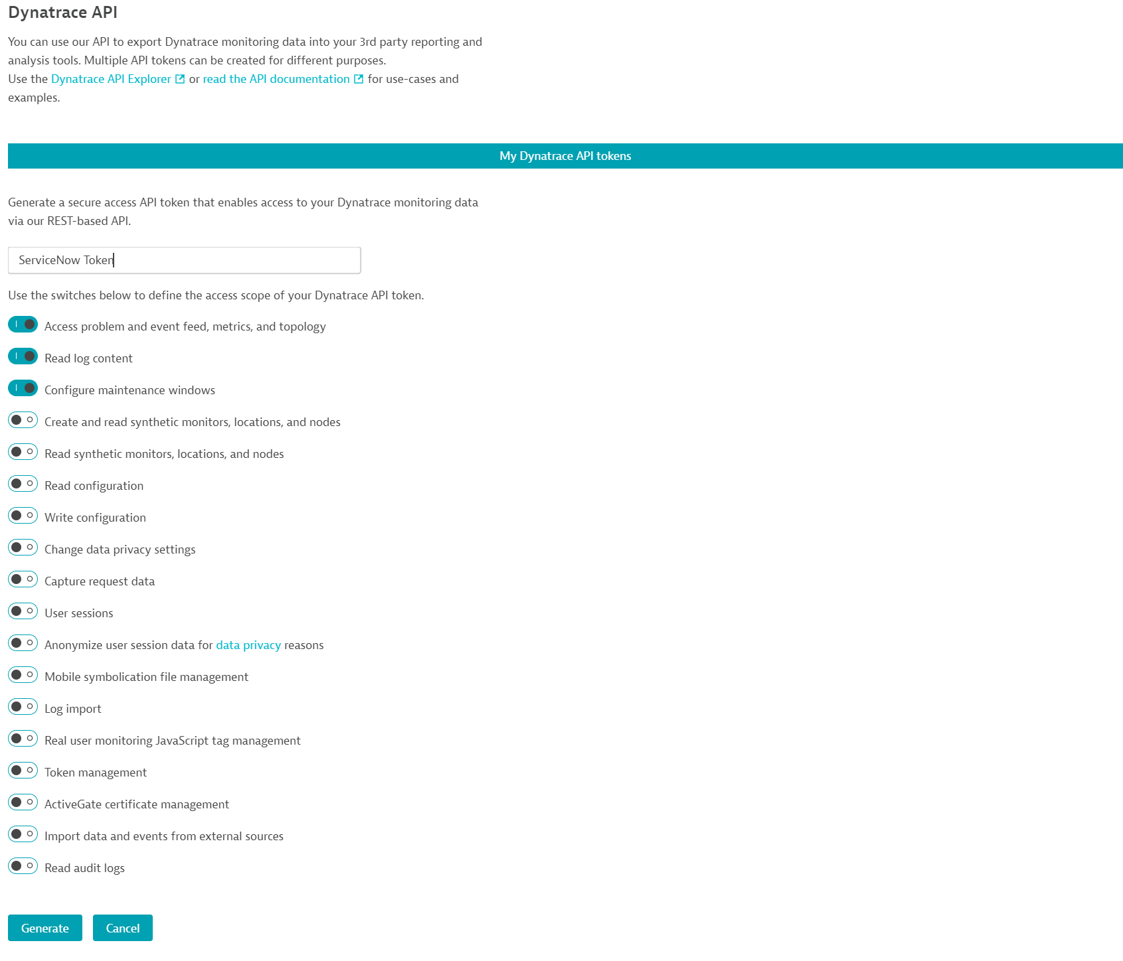
Dynatrace - Generate an API Key
Lab 1
Step 11
Step 12 : Generate an API Key
You'll need an API key for proper integration between Dynatrace and ServiceNow. If you don't already have the API key (token), you can generate it in Dynatrace.
To create an API key for your Dynatrace environment:
In Dynatrace, navigate to Settings > Integration > Dynatrace API.
Type a token name and ensure that the switch for Access problem and event feed, metrics, and topology is enabled.
Click the Generate token button. Use this token to secure communication between Dynatrace and ServiceNow.

Slide 39
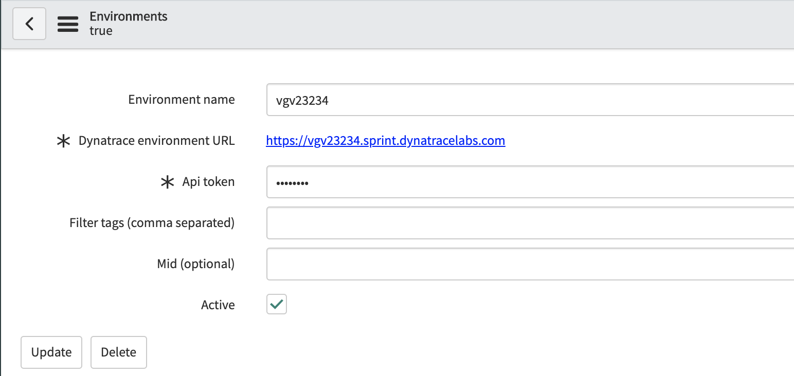
ServiceNow Environment Module setup
Lab 1
Step 12
Step 11 : Configure ServiceNow Dynatrace settings
To complete the configuration on the ServiceNow side:
Create a new environment.
Add an environment name (can be the envrionment ID).
Copy and paste your Dynatrace environment URL and API key into the Dynatrace environments table within ServiceNow.

Slide 40
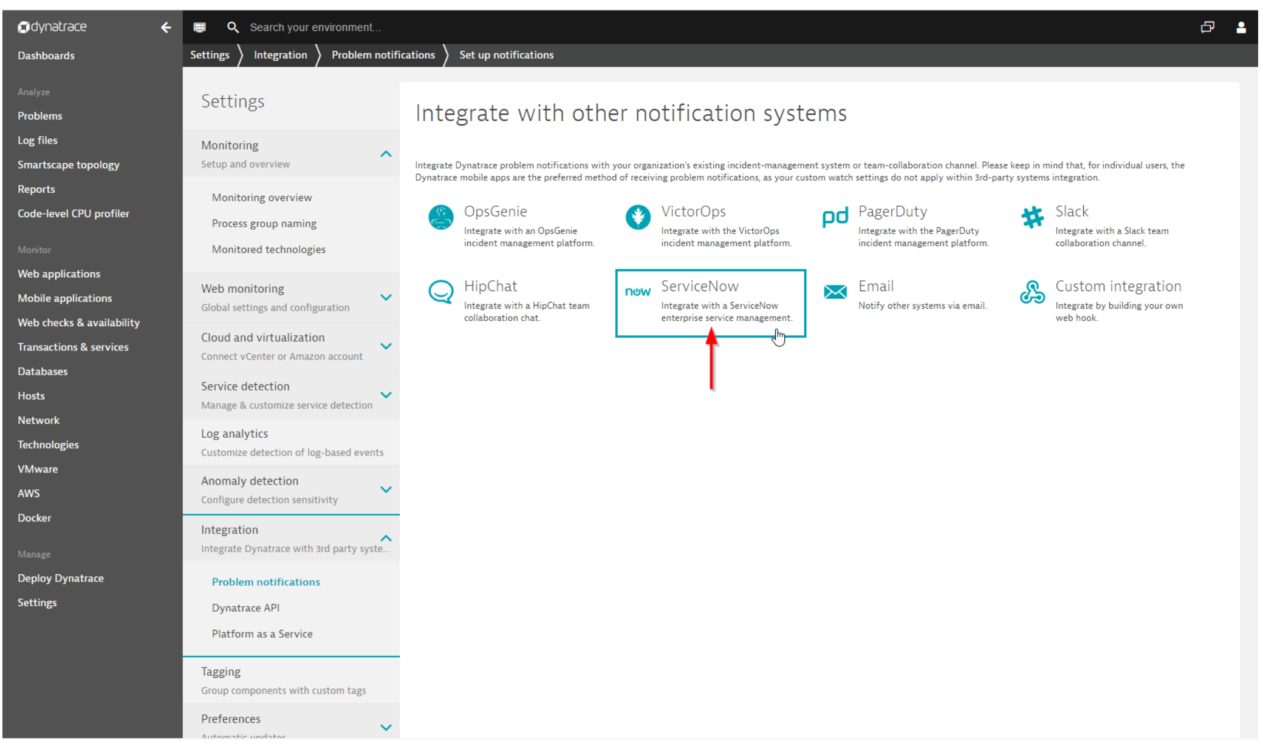
Configure the ServiceNow problem integration on Dynatrace side
Lab 1
Step 13
Step 13
After installing and configuring Dynatrace integration on the ServiceNow side, switch over to your Dynatrace environment.
Navigate to Dynatrace > Settings > Integration > Problem notifications, click Set up notifications, and select ServiceNow.

Slide 41
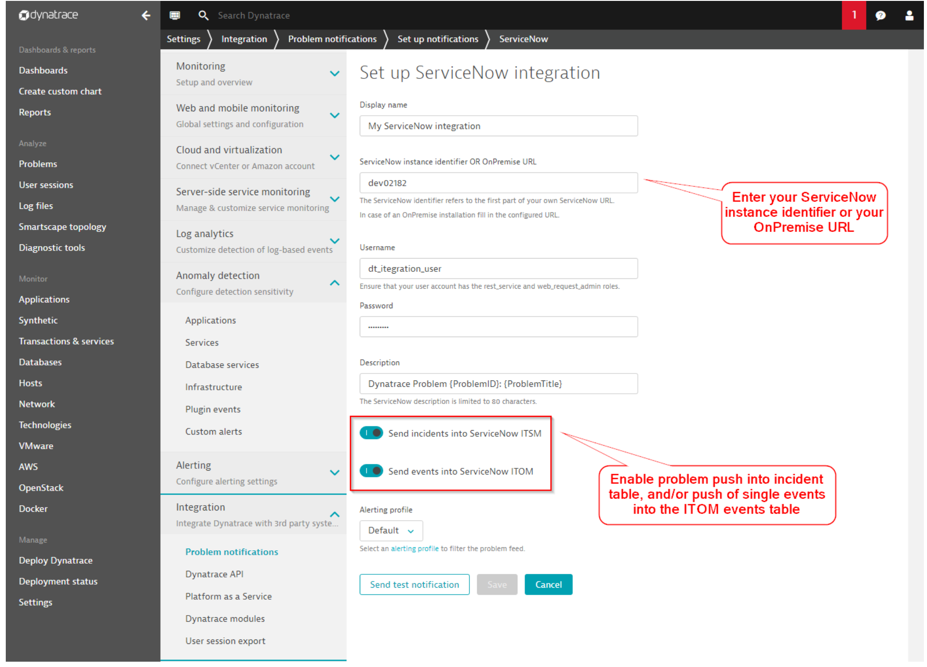
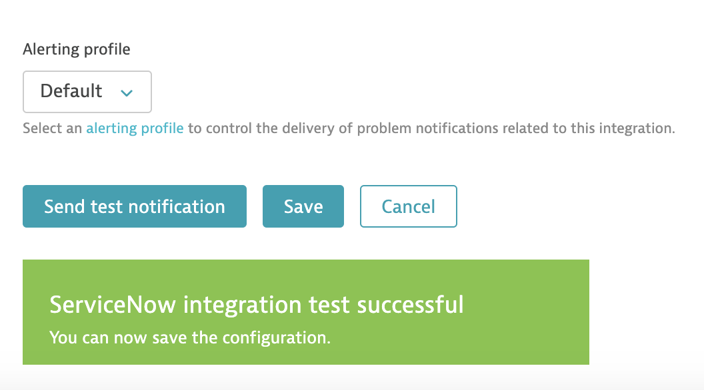
Configure the ServiceNow problem integration on Dynatrace side
Lab 1
Step 14
Step 14
On the Set up ServiceNow integration page, type a custom name for your new integration (for example, My new ServiceNow Integration). Enter your ServiceNow instance identifier as shown above (for example, dev23082) and enter a ServiceNow username that has the following roles assigned to it:
x_dynat_ruxit.Integration, rest_service and web_service_admin
If you're running a ServiceNow instance within your own domain, use the domain of your instance instead of the instance identifier.
Add the following placeholders in the Description field of the integration page: {State}: {ProblemImpact}: {ProblemID}: {ProblemTitle}: {ProblemSeverity}
Ensure that the toggles for Send incidents into ServiceNow ITSM and Send events into ServiceNow ITOM are both enabled
Click on Send Test Notification and save.

Slide 42
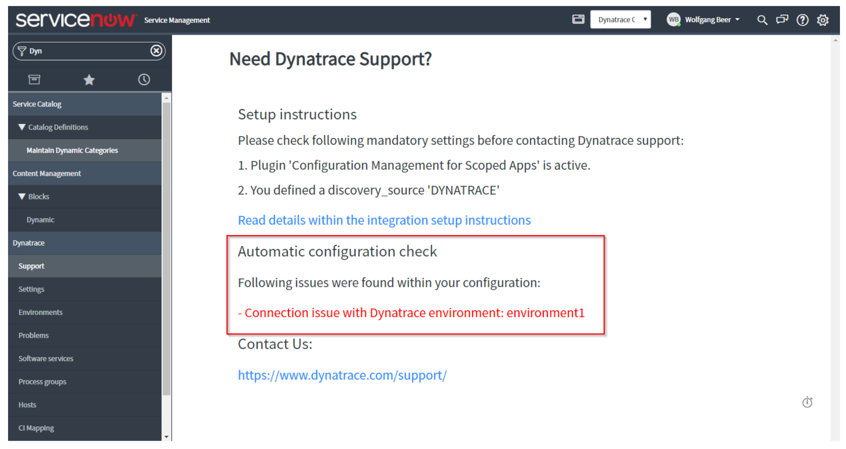
Automatic Configuration Check
Lab 1
Step 15
Step 15
Setting up the integration manually can be tricky, especially when every configuration setting is correct and the Dynatrace API can be reached through firewalls. To help you with the set-up process, the integration app contains an automatic configuration checker that helps you identify the exact problem. The following images compare a successful configuration with an unsuccessful one:

Slide 43
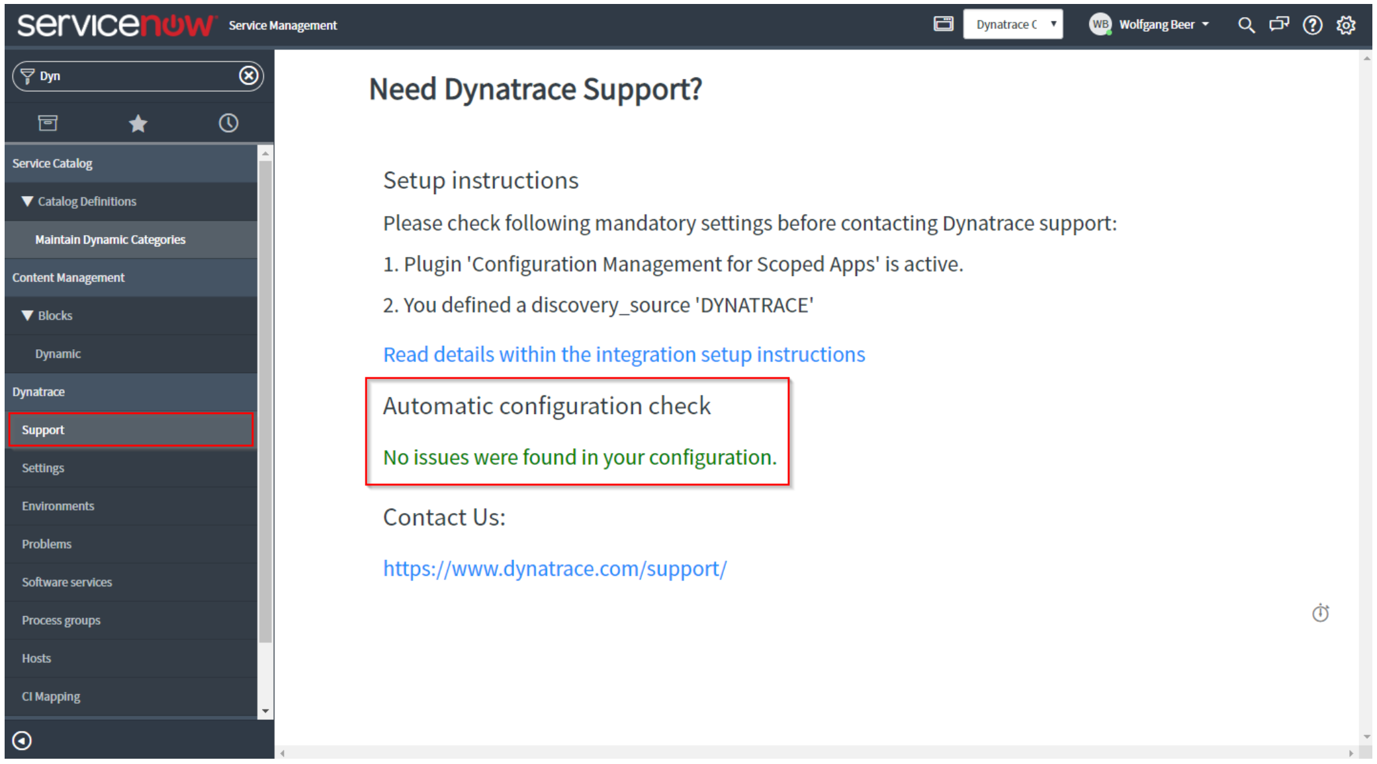
Automatic Configuration Check
Lab 1
Step 15
Step 15 : Successful Configuration Check

Slide 44
Problem Notification Placeholders
Lab 1
Step 16
{PID}: A unique system identifier of the reported problem.
{ProblemDetailsHTML}: Problem event details including the root cause as an HTML-formatted string.
{ProblemID}: ID number of the reported problem.
{ProblemImpact}: Impact level of the problem. Possible values are APPLICATION, SERVICE, and INFRASTRUCTURE.
{ProblemSeverity}: Severity level of the problem. Possible values are AVAILABILITY, ERROR, PERFORMANCE, RESOURCE_CONTENTION, and CUSTOM_ALERT.
{ProblemTitle}: A short description of the problem.
{State}: Problem state. Possible values are OPEN, RESOLVED and MERGED. MERGED is used for problems that have merged with other existing problems.
{Tags}: Comma-separated list of tags that have been defined for all impacted entities.

Slide 45
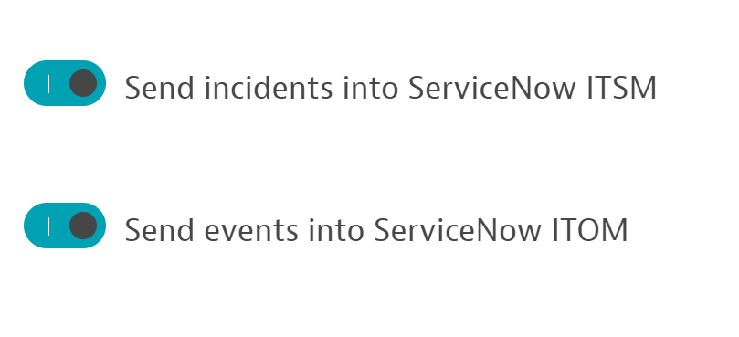
Push Incidents and/or ITOM events
Lab 1
Step 17
By using the toggles for sending incidents and/or ITOM events, you can control when Dynatrace should automatically create an incident within the ServiceNow ITSM module and if all individual correlated events should be pushed into the ServiceNow ITOM events API. Keep in mind that the integration will fail if ITOM is enabled but not activated in your ServiceNow instance.

Slide 46
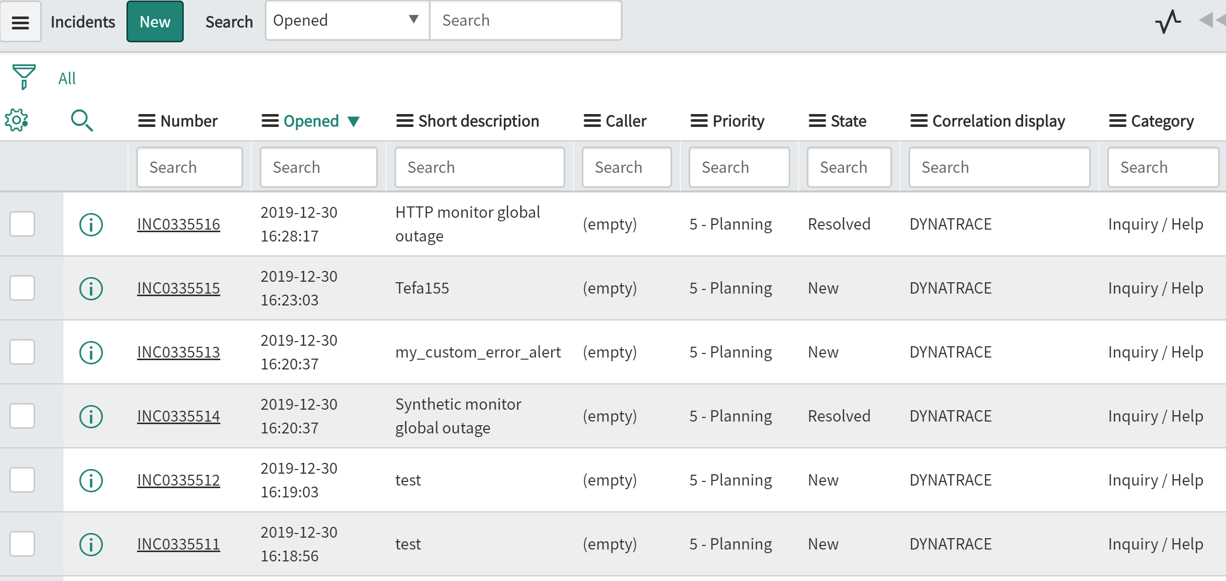
Incidents view in ServiceNow instance
Lab 1
Step 18
Automatic incident creation
After configuration is complete on both the sides, Dynatrace as well as ServiceNow, problem notifications are pushed from Dynatrace to your ServiceNow instance, as shown below:

Slide 47
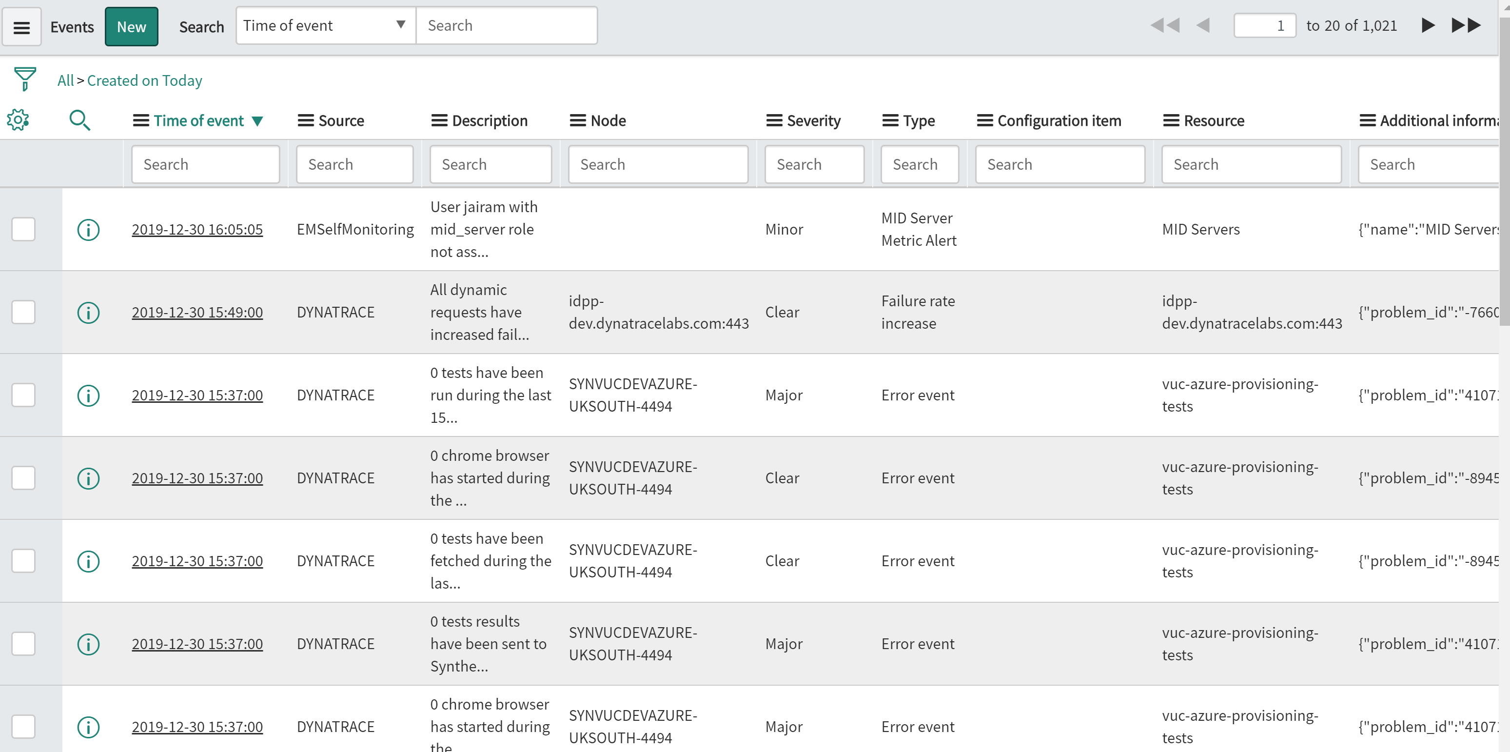
Events view in ServiceNow instance
Lab 1
Step 19
Automatic Events creation
After configuration is complete on both the sides, Dynatrace as well as ServiceNow, Events are pushed from Dynatrace to your ServiceNow instance, as shown below:

Slide 48
Dynatrace Scoped App Main Modules
Lab 1
After you've installed the Dynatrace app within your ServiceNow instance, you’ll find a new Dynatrace menu in ServiceNow with the following entries:
Support: Report issues with your Dynatrace ServiceNow integration to Dynatrace Support.
Dynatrace Settings: Use these settings to configure your Dynatrace integration.
Environments: Configure one or multiple Dynatrace monitoring environments and token credentials to synchronize CMDB information with.
Problems: Import set table that shows the number of Dynatrace-detected problems that have been pushed to and imported into your incident table.
Hosts: A filtered view of your CMDB servers table that shows all Dynatrace-discovered hosts.
Step 20

Slide 49
Dynatrace Managed Tenant variations in setup
Lab 1
Step 21
If you're running a Dynatrace Managed instance, the server runs within your own datacenter. Therefore, a Cluster ActiveGate with a publicly accessible domain is necessary. For Dynatrace Managed installations, the URL pattern looks like the following example:
https://<YOUR_OWN_DOMAIN>/e/caa3369e-8612-46e2-b8c9-4018298cce24/

Slide 50
Dynatrace Managed Tenant – MID Server
Lab 1
Step 21
All ServiceNow-related Dynatrace API requests can be proxied through a selected ServiceNow MID server. If you're running a Dynatrace Managed instance and experiencing issues resulting from corporate firewalls blocking incoming requests to the REST API of your Dynatrace Managed server, you can route these API calls through an already existing MID server.
Simply select one of your configured MID servers in the Dynatrace > Settings > Environments section of ServiceNow. You can even define different MID servers for individual Dynatrace environments.

Slide 51
CMDB Integration of Hosts, Processes, Services from Dynatrace
Lab 1
Step 22
To sync this data, Dynatrace introduces one scheduled job that pulls a subset of the topology information from Dynatrace Smartscape at 10-minute intervals. The Dynatrace sync CMDB job scheduled job pulls all web application information, along with their relation to software services, all host and process group information, and all software services and relationships. The information pull is performed using the official Dynatrace REST API.

Slide 52
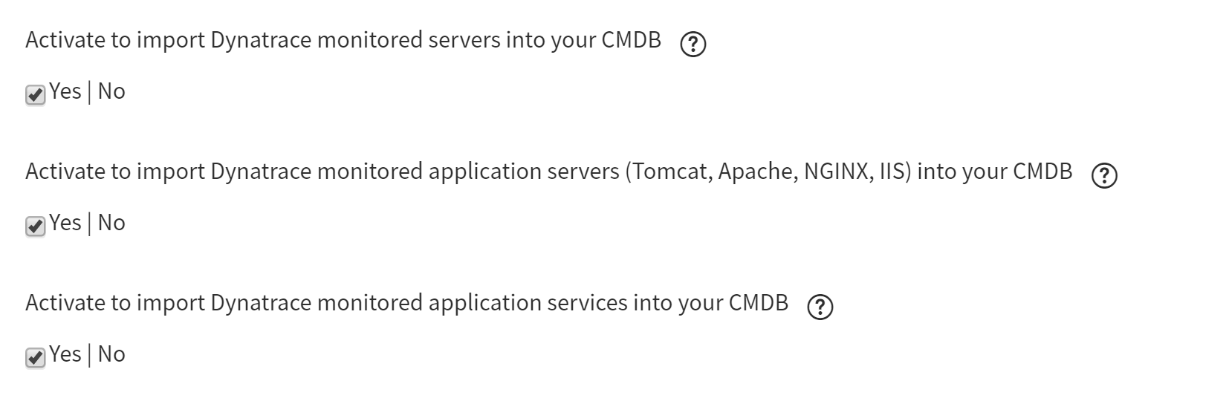
CMDB Integration Settings
Lab 1
Step 23
In the ServiceNow instance, Go to Dynatrace -> Settings Module. Check these properties to enable the CMDB Integration

Slide 53
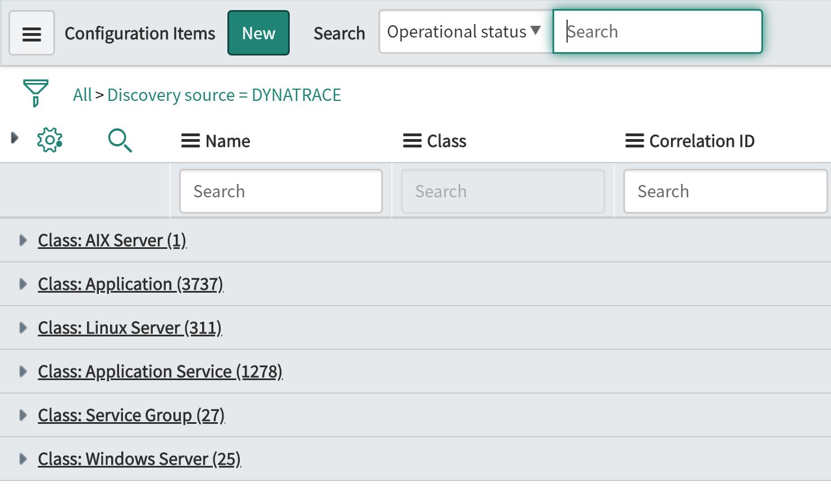
CMDB CI consolidated view
Lab 1
Step 24
All CIs are listed as seen below
AIX, Linux, Windows Servers are Hosts
Application -> Processes
Application Service -> Services
Service Group -> Management Zones

Slide 54


Where are you at!!

Slide 55


Slide 56
Problem Remediation Lab

Slide 57
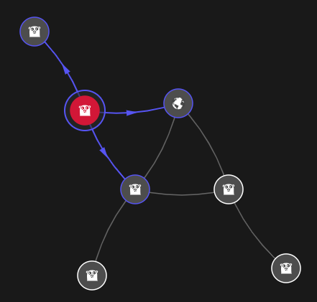

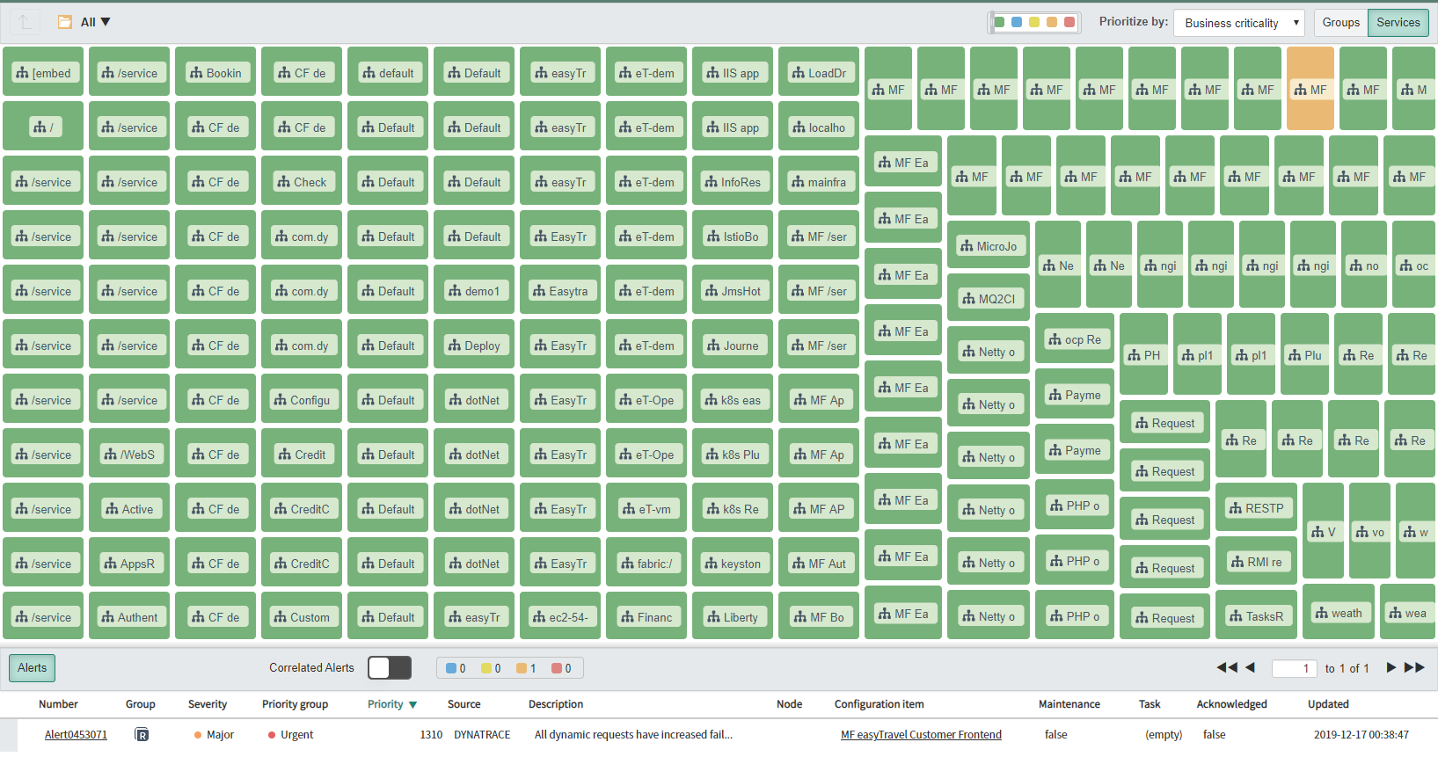
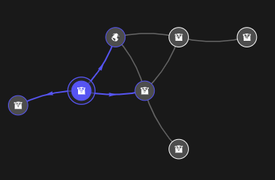

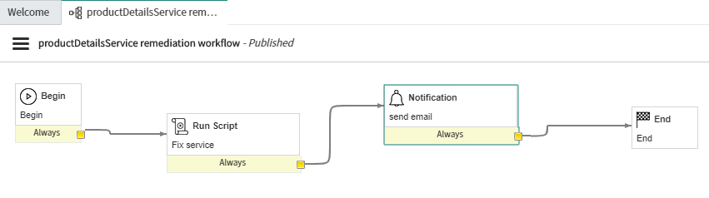
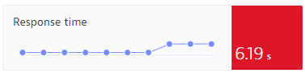
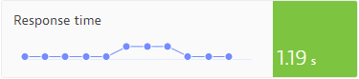
Intro
Lab exercise
Intro
Monitoring
ITOM Events
Workflow
Alert management
Remediation
Todays exercise will show how to monitor a service in Dynatrace, automatically detect a service slowdown and send an incident to a ServiceNow instance.
Finally, this excercise shows how to automatically remediate a broken service.
Notes:
Log into your own ServiceNow instance and import the Dynatrace app update set
Configure a ServiceNow ITOM integration on shared Dynatrace instance
Result: One integration for each participant within the shared DT instance
Setup the CMDB integration with the shared DT instance
Look at a monitored service within the shared DT instance
We trigger a slowdown of the service by calling a HTTP endpoint
Dynatrace alert goes off and is delivered to the participants ServiceNow instances
Alert is received in the participants ITOM table
We define a remediation workflow (create workflow with table: em_remediation_task)
HTTP POST call to Dynatrace that remediates the service performance
We define a ‚Alert Management‘ rule to trigger the remediation workflow
Finish

Slide 58
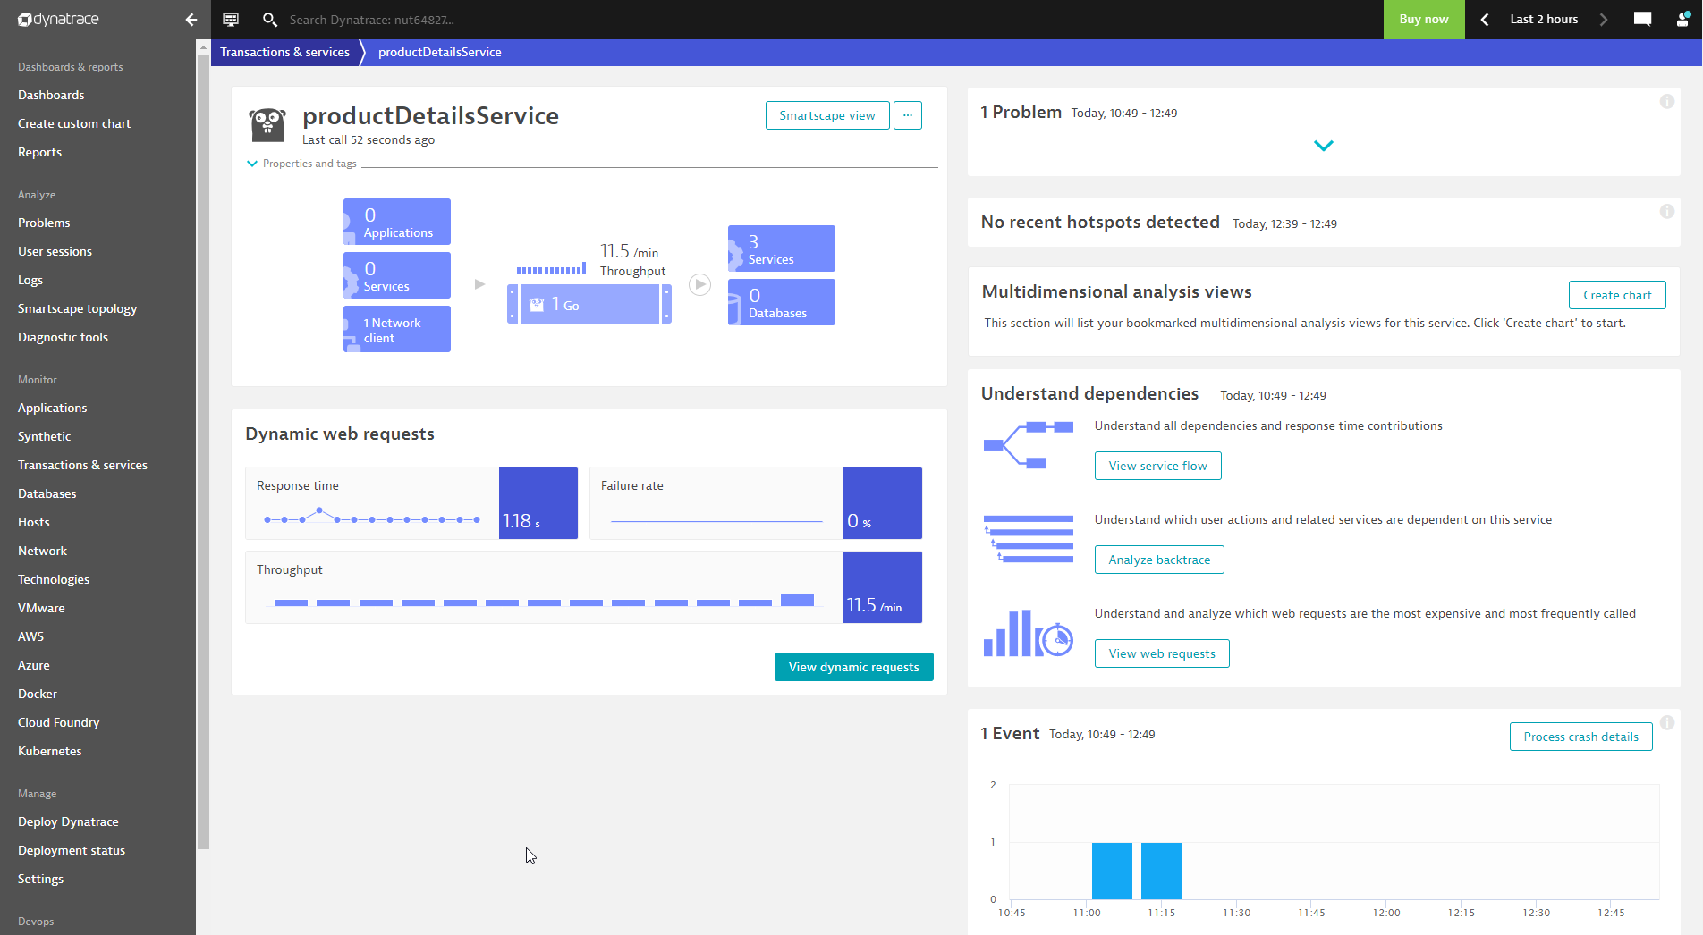
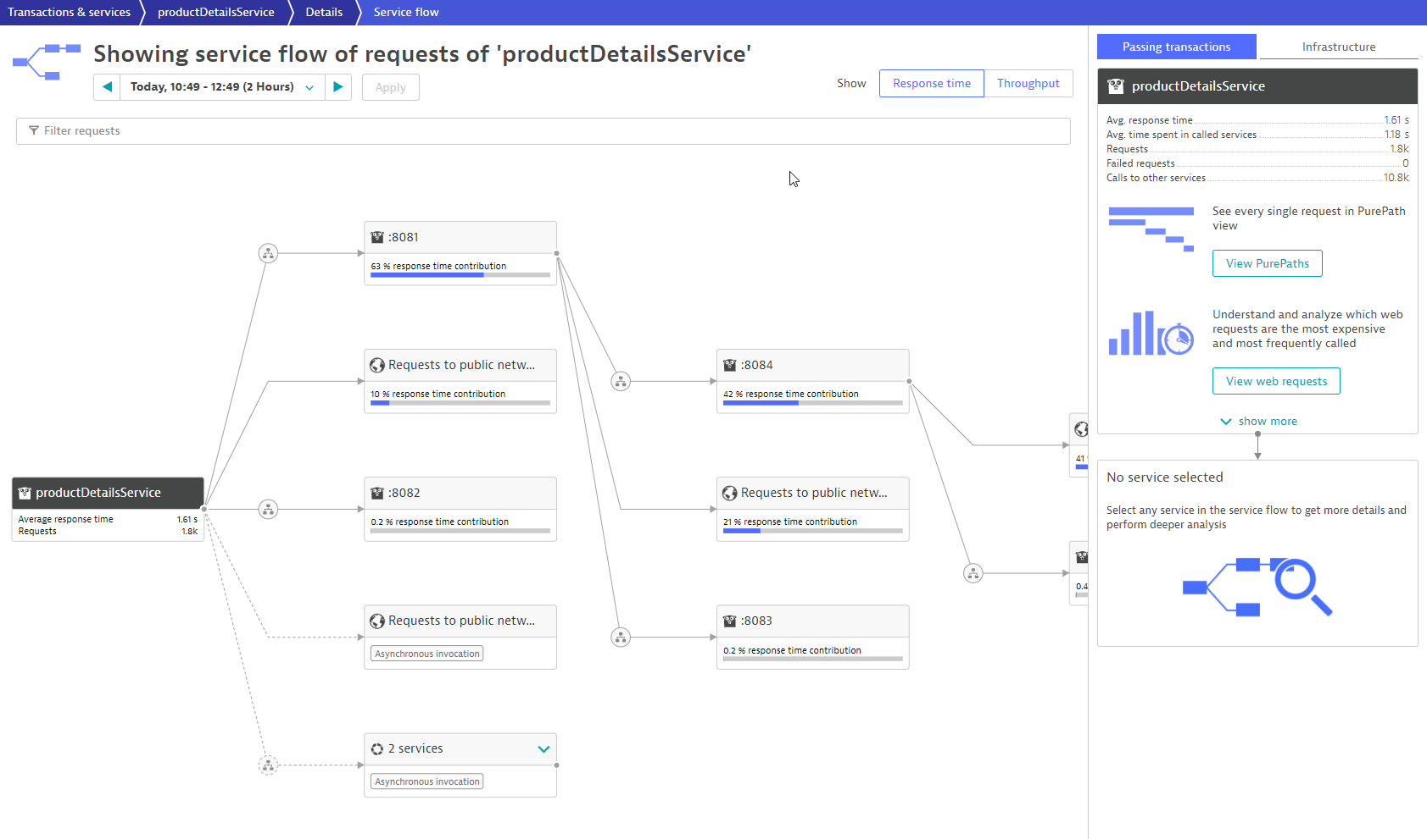
Monitor the Service Performance
Lab exercise
Intro
Monitoring
ITOM Events
Workflow
Alert management
Remediation
Change into the Dynatrace environment
Navigate to the Transactions and Services list
Open the service ‚productDetailsService‘, as shown below:

Slide 59
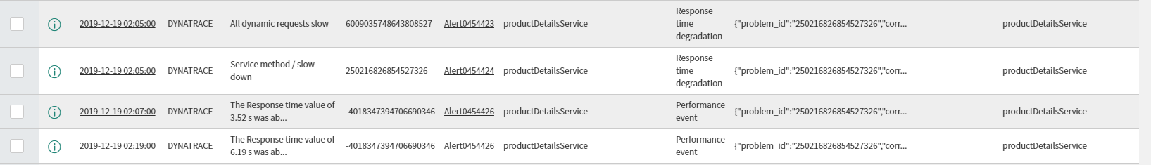
Receive Dynatrace ITOM Events in ServiceNow
Lab exercise
Intro
Monitoring
ITOM Events
Workflow
Alert management
Remediation
Now its time to slow down the service!
Dynatrace automatically detects the slowdown
An incident is opened in ServiceNow and all raw events are sent into ServiceNow ITOM event table, as shown below:

Slide 60
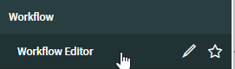
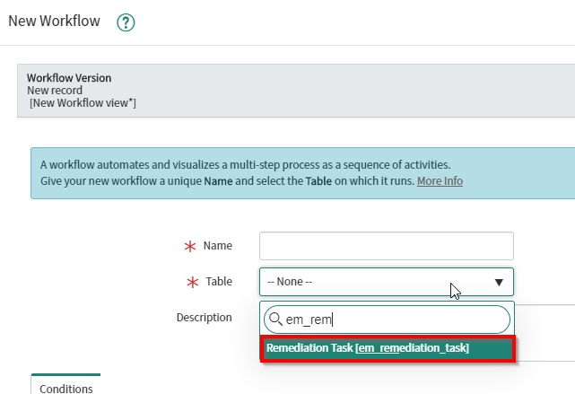
Define a Remediation Workflow in ServiceNow
Lab exercise
Intro
Monitoring
ITOM Events
Workflow
Alert management
Remediation
Within ServiceNow, navigate to workflow editor.
Create a new workflow with target table ‚em_remediation_task‘:

Slide 61
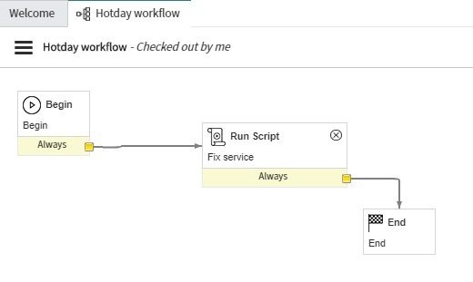
Define a Remediation Workflow in ServiceNow
Lab exercise
Intro
Monitoring
ITOM Events
Workflow
Alert management
Remediation
Create a workflow with a script step as shown below:
Copy the service fix code into the script step. You find the fix script on Github:
https://github.com/wolfgangB33r/Perform2020Hotday/blob/master/servicefixscript.js

Slide 62
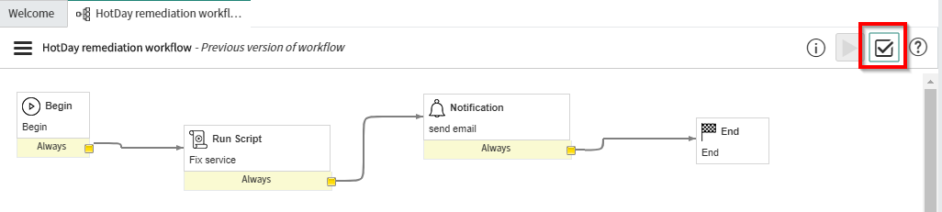
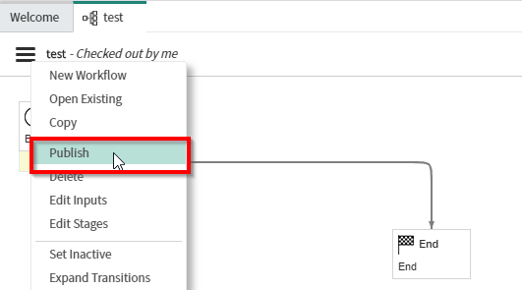
Define a Remediation Workflow in ServiceNow
Lab exercise
Intro
Monitoring
ITOM Events
Workflow
Alert management
Remediation
Validate your workflow:
Publish your workflow:

Slide 63

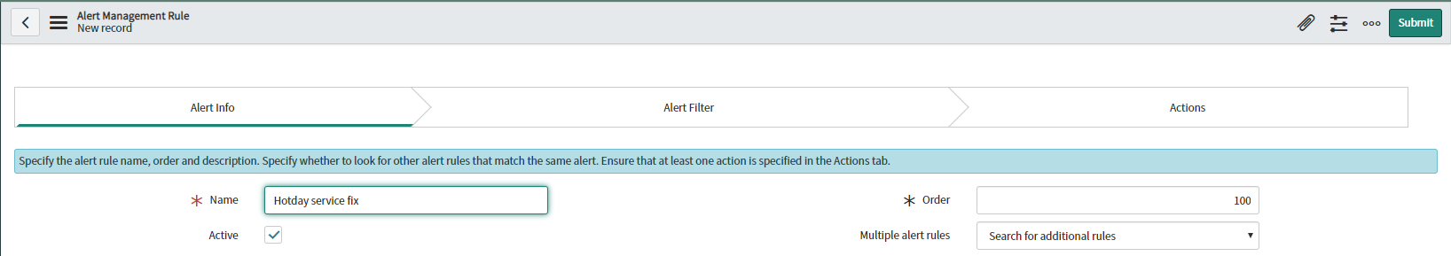
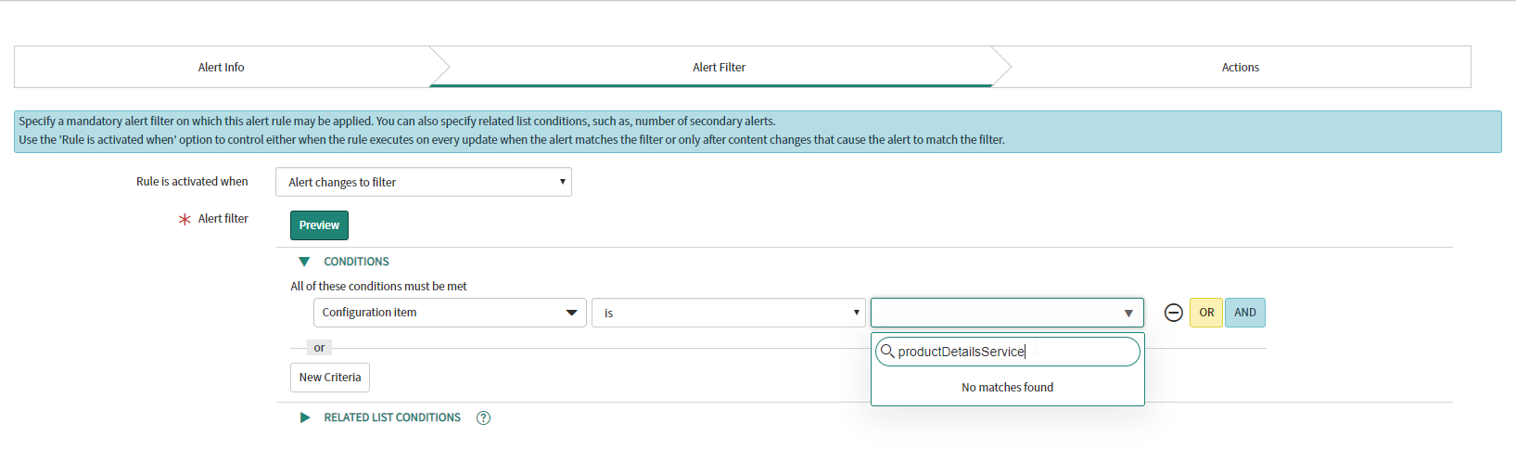
Alert Management
Lab exercise
Intro
Monitoring
ITOM Events
Workflow
Alert management
Remediation
Finally, we have to connect the alert with our remediation workflow.
Within ServiceNow, navigate to ‚Alert Management‘
Create a new alert management rule
Bind it to the CMDB synced ‚productDetailsService‘, as it is shown below:

Slide 64
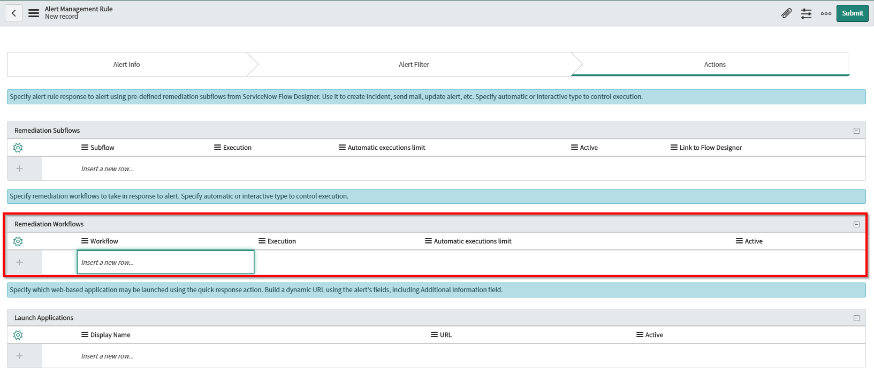
Remediation
Lab exercise
Intro
Monitoring
ITOM Events
Workflow
Alert management
Remediation
Attach the remediation workflow to your alerting management rule.

Slide 65
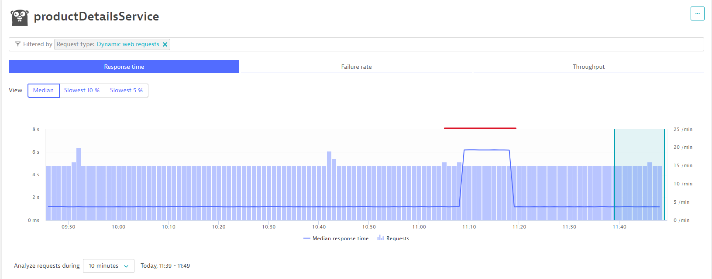
Remediation
Lab exercise
Intro
Monitoring
ITOM Events
Workflow
Alert management
Remediation
Now as we have autoremediation fully configured, lets do a full run of the scenario.
Problem is fixed after around 7 minutes automatically, instead of running for hours:
Fixed automatically after 7 minutes,
instead of hours!

Slide 66
Summary

Slide 67
What we have achieved in the demo
Release of a new feature
Dynatrace detects increase of failure rate
Dynatrace fires a problem
Problem delivered to ServiceNow
ITOM event rule triggers Remediation
Remediation script is executed
Problem is remediated

Slide 68
Outlook and Roadmap

Slide 69
Dynatrace and ServiceNow, what‘s next?
Orlando
Robust Transport Engine (RTE) Support
Alert Correlation Rules
Web Applications Synchronization
Orchestration Package

Slide 70
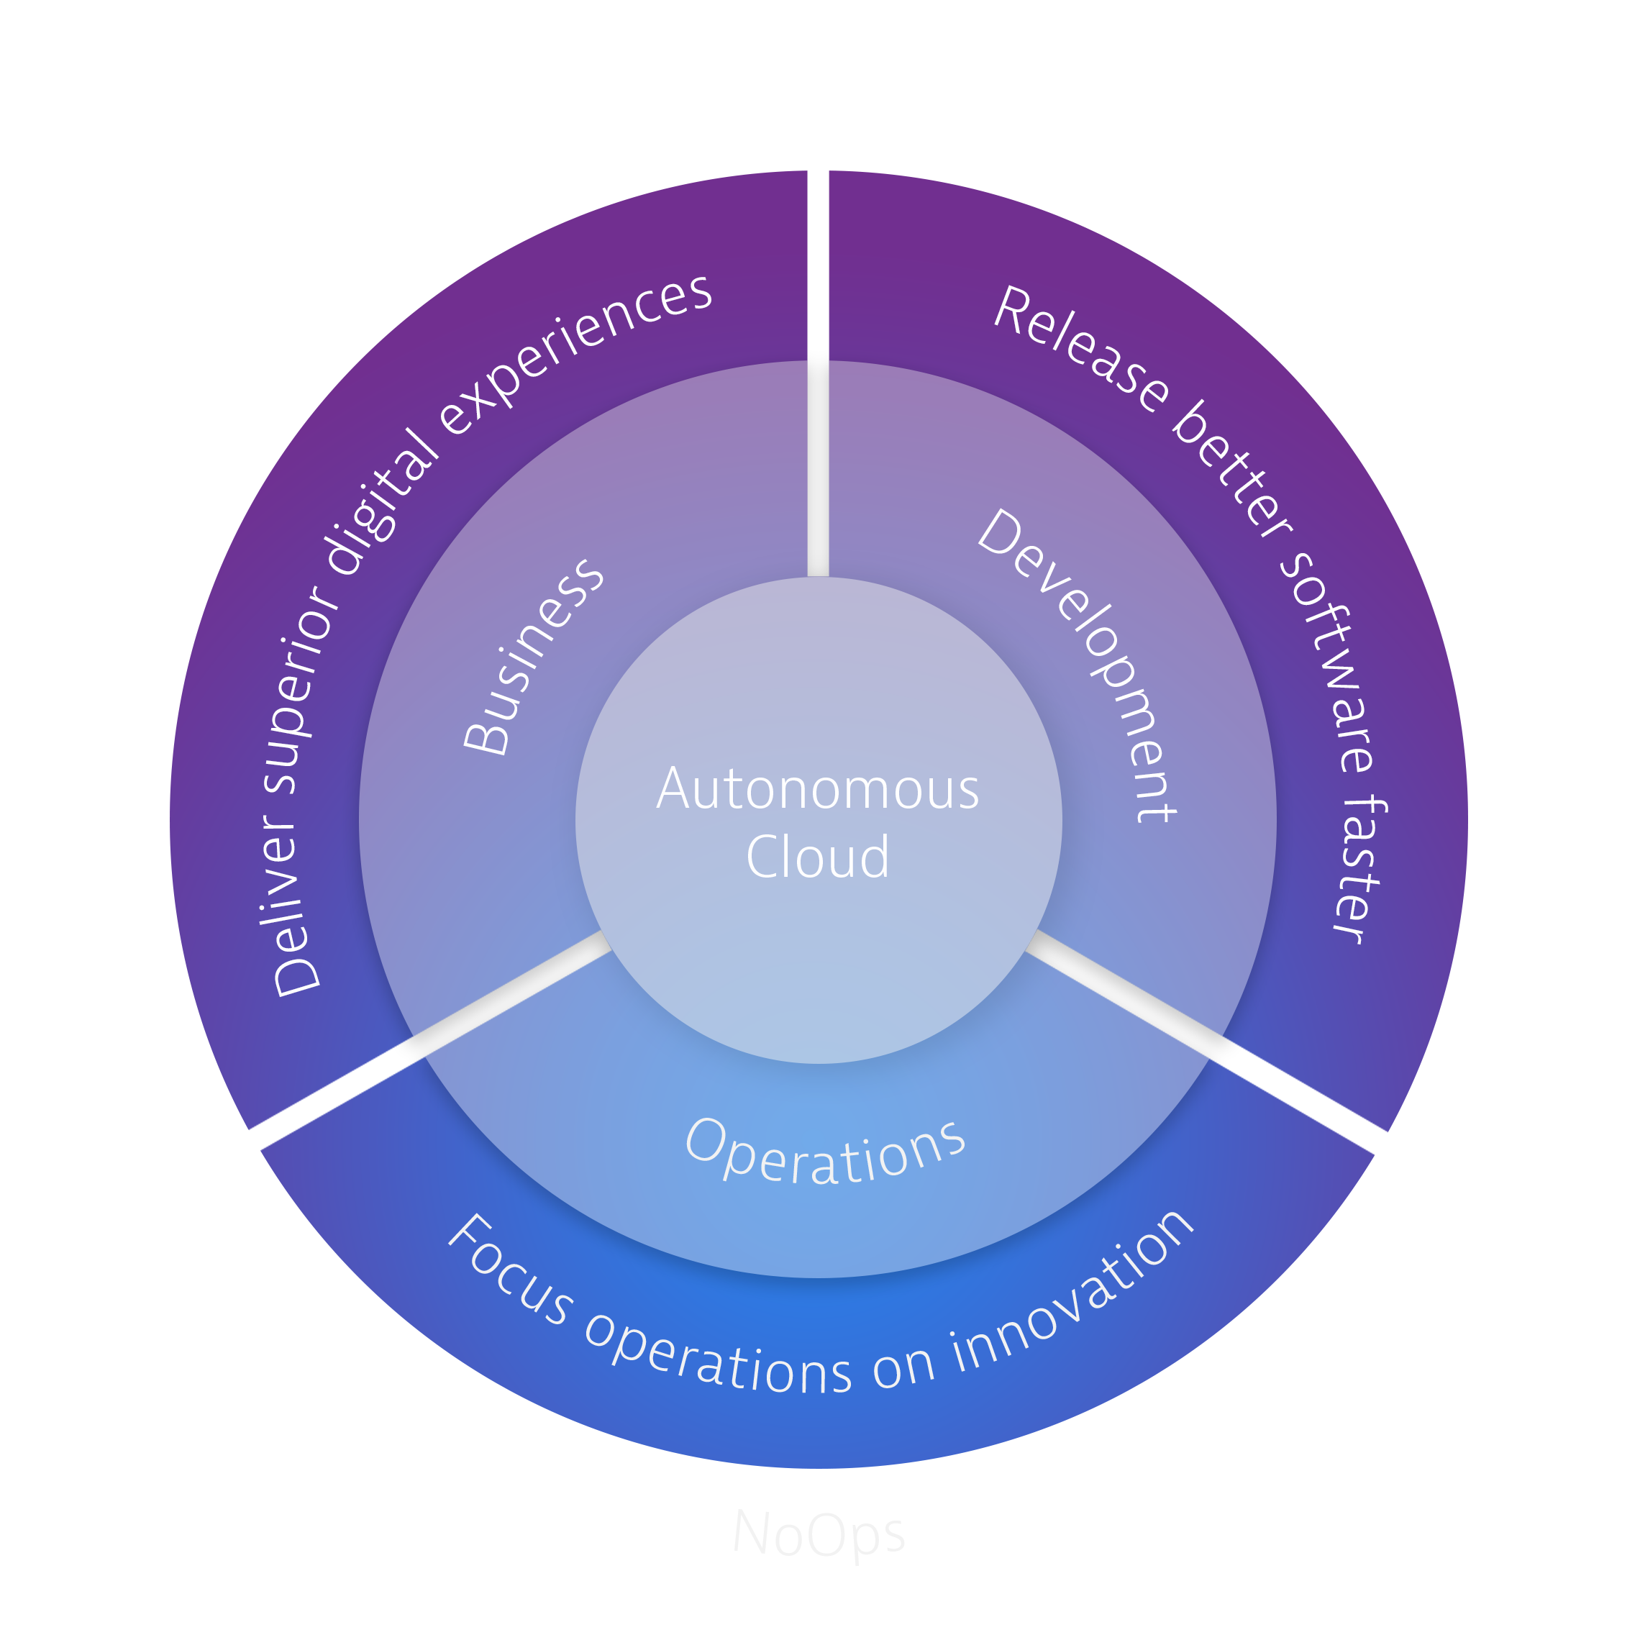
Autonomous Cloud Enablement
Automation Services
Monitoring as a Service
Automated Quality Gates
Automated Incident Management
Automated Problem Remediation
Like what you saw today?
Visit the Innovation Expo or University booth for more information.
www.dynatrace.com/services-support/autonomous-cloud-enablement/

Slide 71

Autonomous Cloud Enablement
Autonomous Cloud Labs
It not just a training…it’s an immersive lab experience
Like what you saw today?
Visit the Innovation Expo or University booth for more information.
www.dynatrace.com/services-support/autonomous-cloud-enablement/

Slide 72


